Slide 1

DMoE-OTA: Distributed Mix-of-Expert with Over-The-Air
Zhuoyu Yao, Yue Wang
Computer Science
Georgia State University, Atlanta, GA, USA
Dec 3, 2024
Notes:
Hello

Slide 2
Outline
Introduction
Existing research
Proposed design and method
Preliminary results
Summary and future work

Slide 3
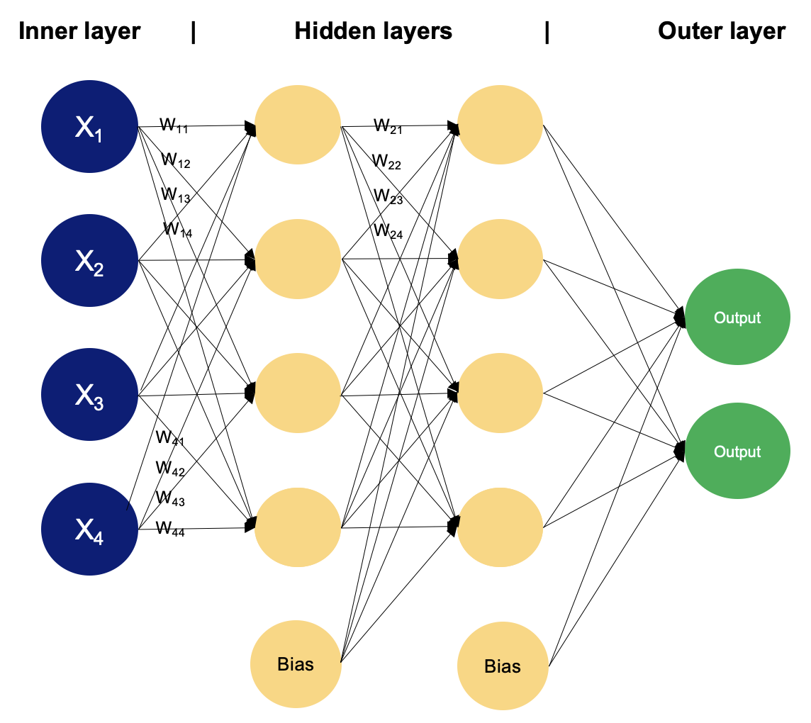
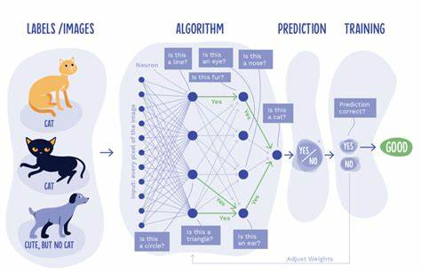
Introduction – Deep Learning
To learn a complex function from data
Machine Learning
Least Square Method
SVM
Multi-Layer Perception
…
Deep Learning
CNN
RNN
…
Notes:
Least Squares Method multilayer preception

Slide 4
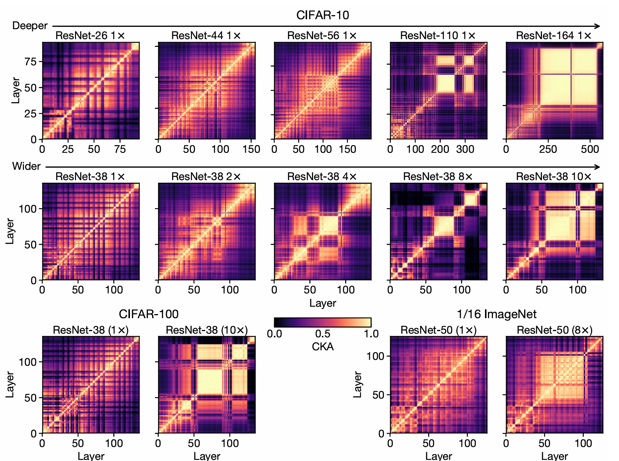
Introduction – Deep Learning
‘Depth’ and ‘Width’ is the same things
Deep vs. Wide
Pros of ‘deep’
Hierarchical Feature Extraction
Easy to train
Good to non-linear fit
Cons of ‘wide’
Not good at generalization
Resource cost
Larger scale parameterization
[1] Nguyen T, Raghu M, Kornblith S. Do wide and deep networks learn the same things? uncovering how neural network representations vary with width and depth[J]. arXiv preprint arXiv:2010.15327, 2020..

Slide 5
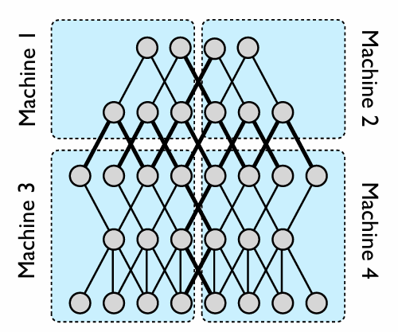
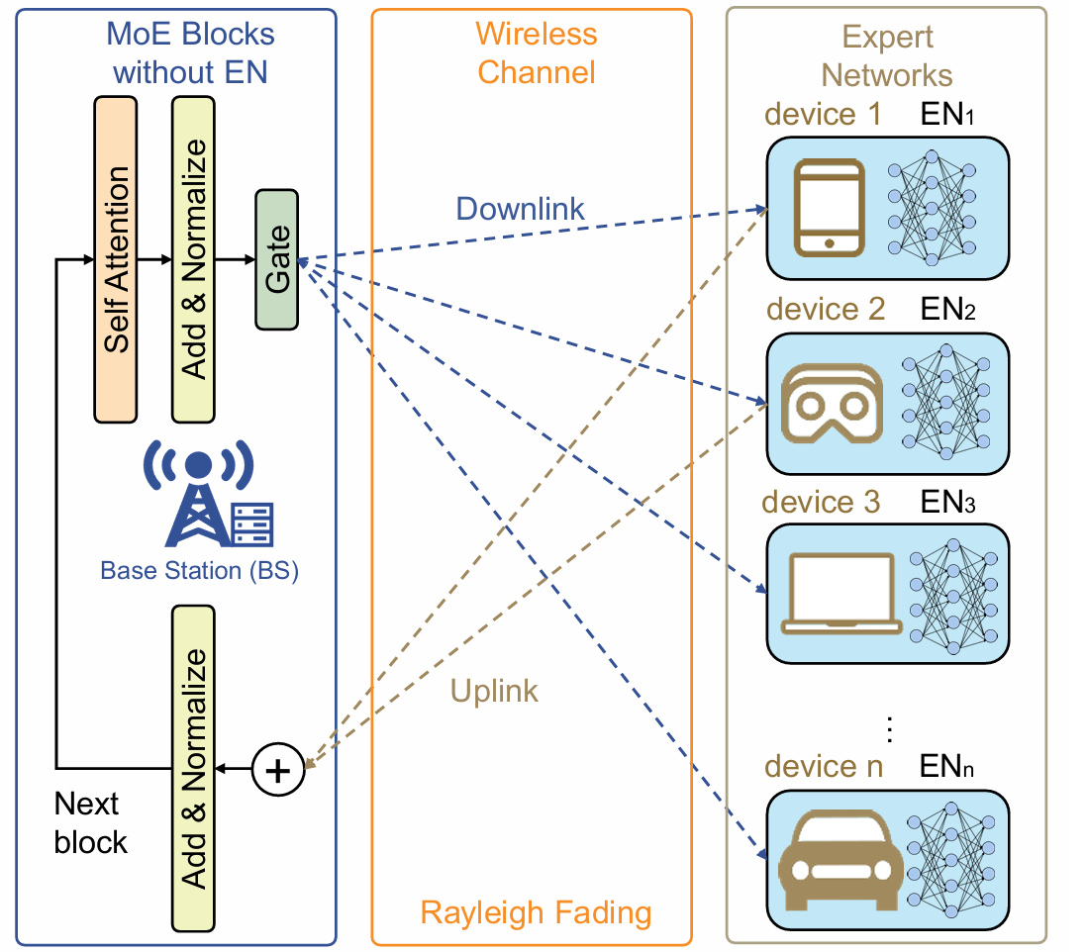
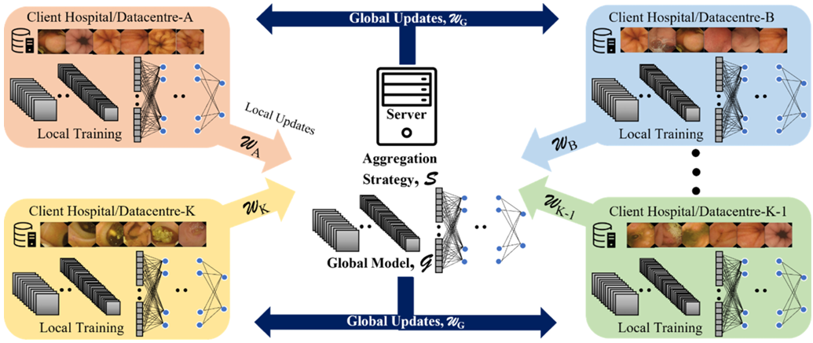
Introduction – Wide Learning
Pros of wide learning (for large model)
Scalable
Parallel training
Easy to deploy on IoT System
Standard Distributed Deep Learning^{[1]}
Module based Distributed Deep Learning ^{[2]}
Wide Learning ^{[3]}
[1] Wahab H, Mehmood I, Ugail H, et al. Federated Deep Learning for Wireless Capsule Endoscopy Analysis: Enabling Collaboration Across Multiple Data Centers for Robust Learning of Diverse Pathologies[J]. Future Generation Computer Systems, 2024, 152: 361-371.
【2】 Dean J, Corrado G, Monga R, et al. Large scale distributed deep networks[J]. Advances in neural information processing systems, 2012, 25.
[3] Xue N, Sun Y, Chen Z, et al. WDMoE: Wireless Distributed Mixture of Experts for Large Language Models[J]. arXiv preprint arXiv:2411.06681, 2024.

Slide 6
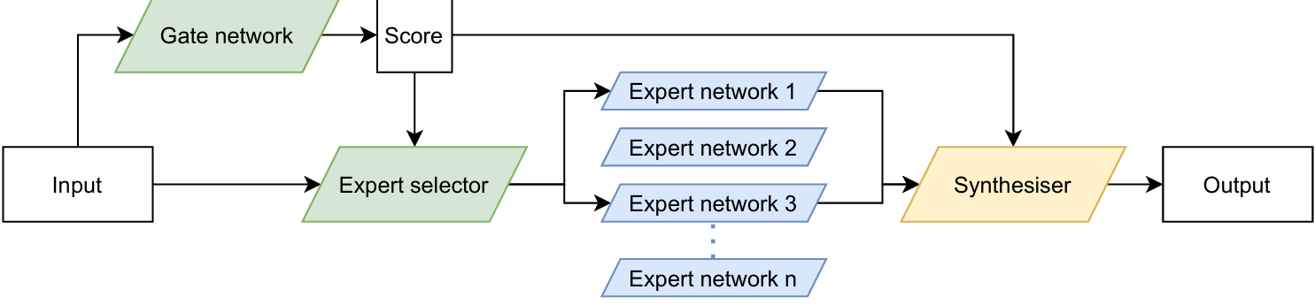
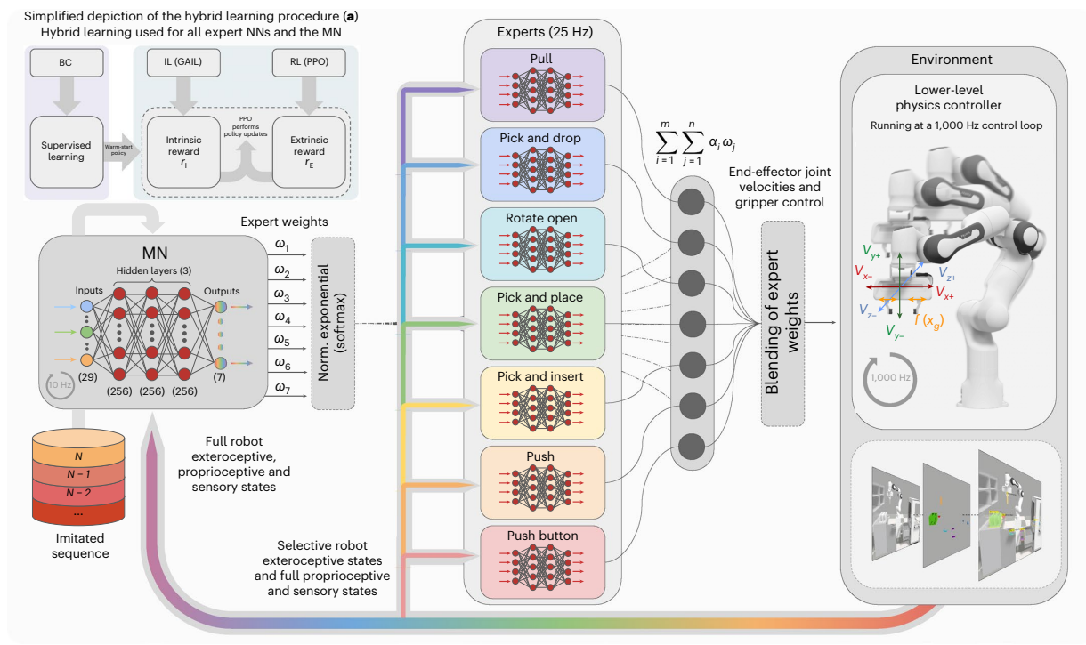
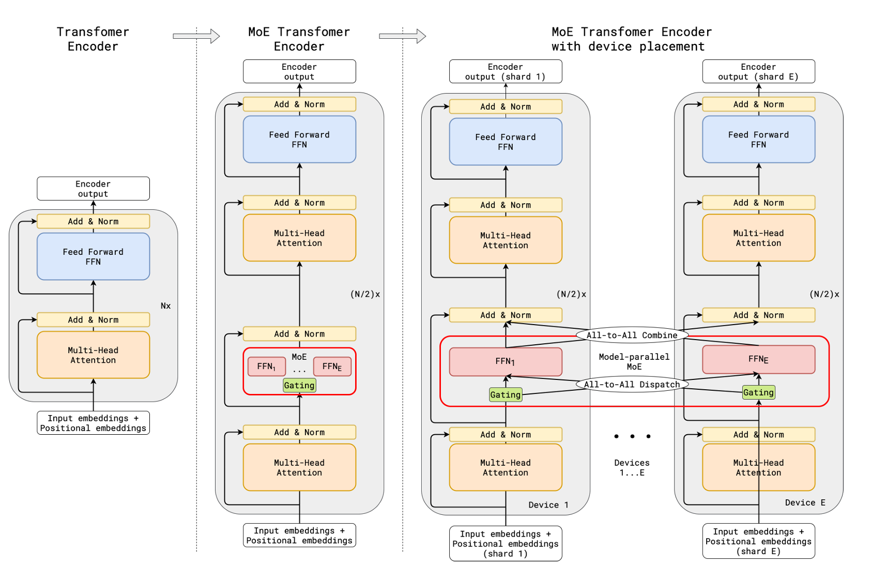
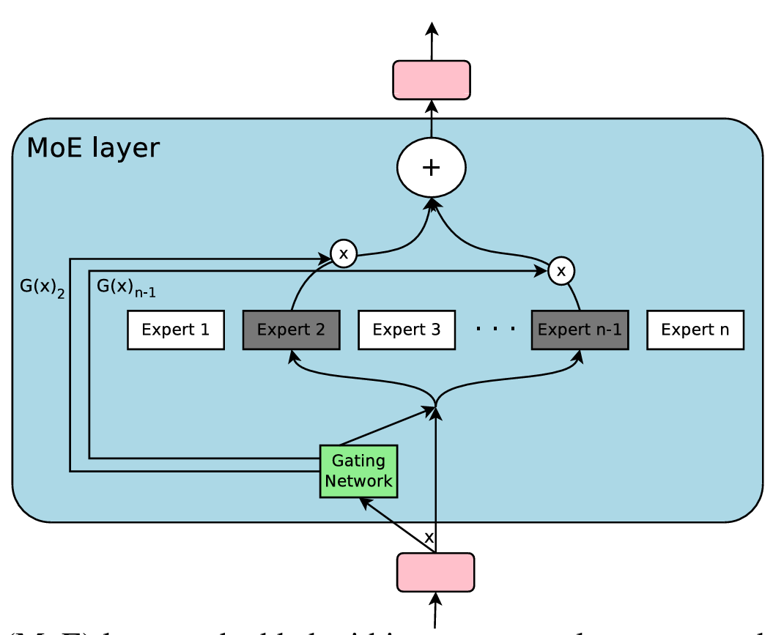
Introduction – Mix of Expert (MoE)
MoE: Train experts for specific Tasks (Distributed Multi-tasks Framework).
A framework for training wider nets.
Easy-to-use
Efficient training
Scalable system
Privacy ensure
MoE Structure ^{[1]}
Layer-level MoE ^{[2],[3]}
System-level MoE ^{[4]}
[1] He J, Qiu J, Zeng A, et al. Fastmoe: A fast mixture-of-expert training system[J]. arXiv preprint arXiv:2103.13262, 2021.
[2] Lepikhin D, Lee H J, Xu Y, et al. Gshard: Scaling giant models with conditional computation and automatic sharding[J]. arXiv preprint arXiv:2006.16668, 2020.
[3] Luo J, Chen C, Wu S. Mixture of Experts Made Personalized: Federated Prompt Learning for Vision-Language Models[J]. arXiv preprint arXiv:2410.10114, 2024.
[4] Triantafyllidis E, Acero F, Liu Z, et al. Hybrid hierarchical learning for solving complex sequential tasks using the robotic manipulation network ROMAN[J]. Nature Machine Intelligence, 2023, 5(9): 991-1005.
Notes:
Width learning 不能实现完整的feed-back

Slide 7
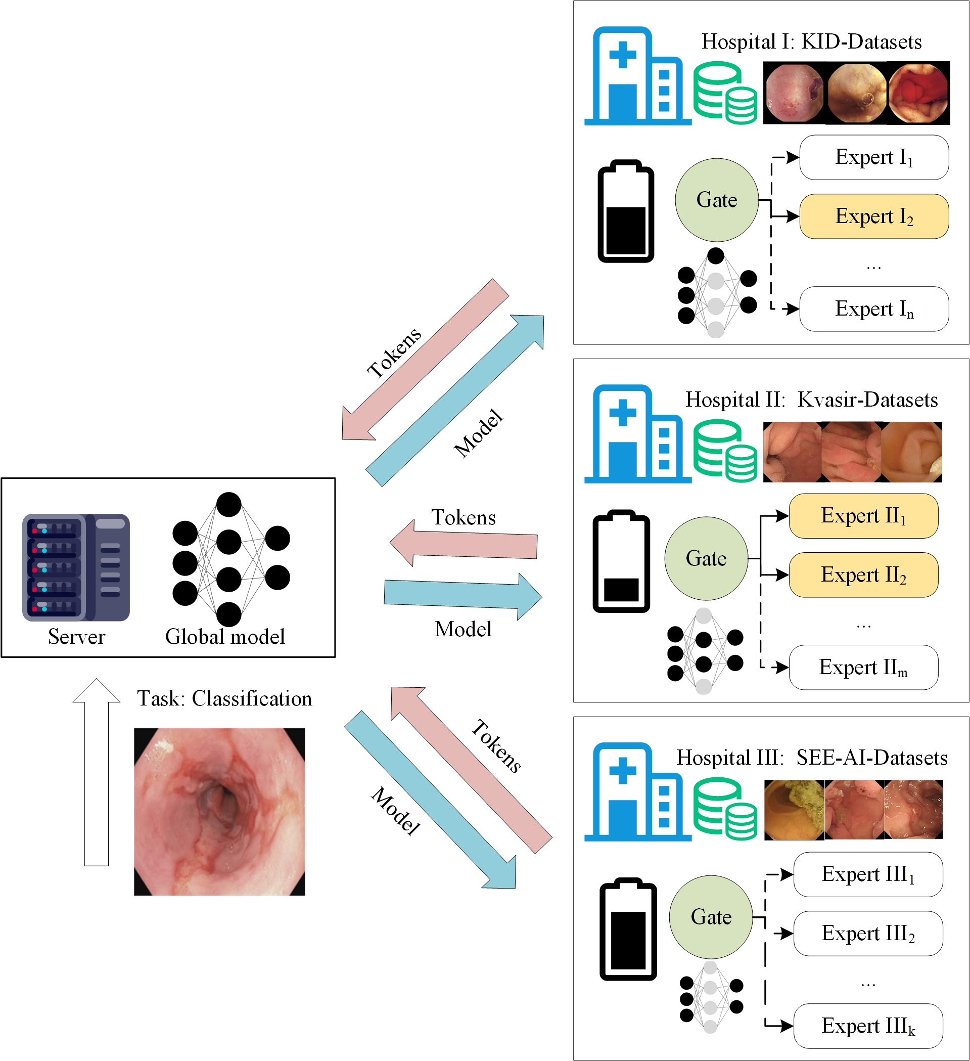
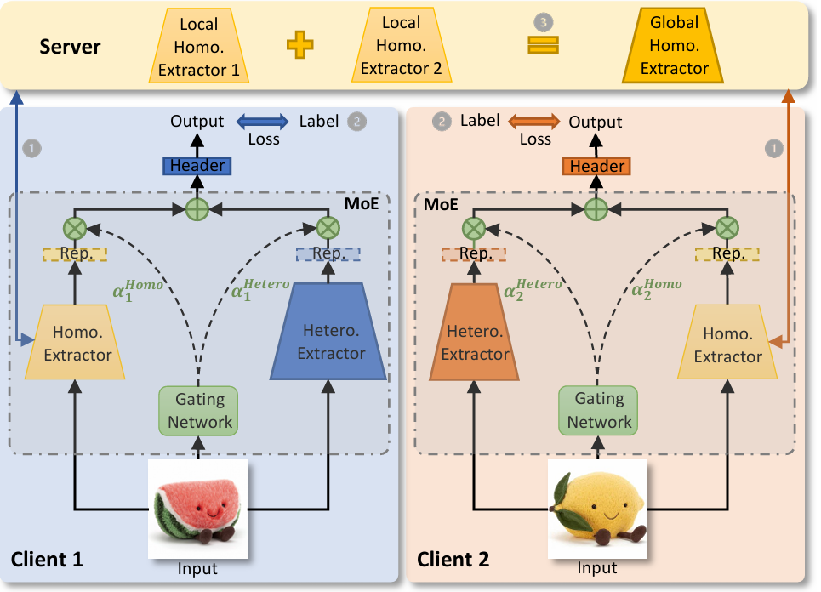
Introduction –Distributed MoE
Distributed MoE: Train experts for specific Tasks.
Faster Training^{[2]}
Personalized Training^{[1]}
[1] Yi L, Yu H, Ren C, et al. FedMoE: Data-Level Personalization with Mixture of Experts for Model-Heterogeneous Personalized Federated Learning[J]. arXiv preprint arXiv:2402.01350, 2024.
[2] Yuan X, Kong W, Luo Z, et al. Efficient Inference Offloading for Mixture-of-Experts Large Language Models in Internet of Medical Things[J]. Electronics, 2024, 13(11): 2077.

Slide 8
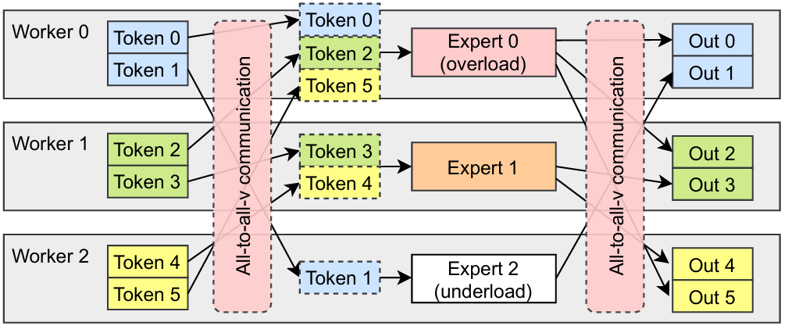
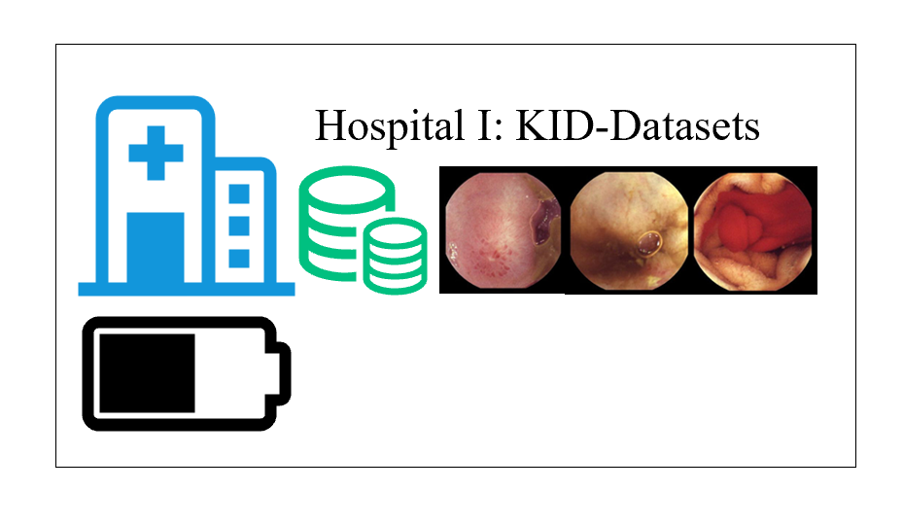
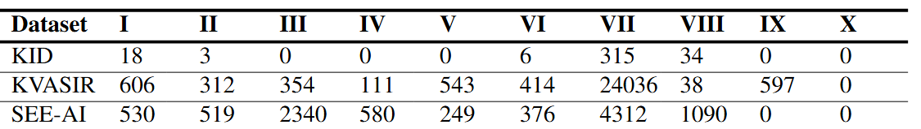
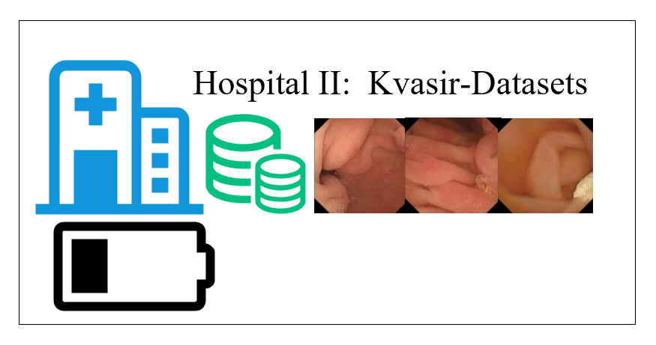
Introduction – Mix of Expert
Challenges in Distributed MoE
✗
Communication bottleneck
✗
Data/device heterogeneity
✗
Balanced training
✗
Privacy Concern

Slide 9
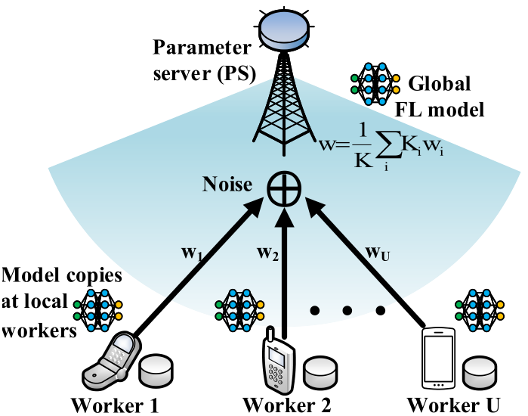

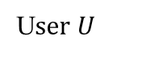
Introduction - Over-the-Air (OTA)
Parameters Aggregation: Over-the-air^{[1]}
User 1
User 2
…
Multiple Access Channel
U$ser U$
Increase U-time commun. Efficiency
Unreachable local params for server
Expensively rely on orthogonal link resources
Sum comes naturally via analog aggregation
[1] Fan X, Wang Y, Huo Y, et al. Joint optimization of communications and federated learning over the air[J]. IEEE Trans. Wireless Commun., vol. 21, no. 6, pp. 4434-4449, 2021.

Slide 10
Outline
Introduction
Existing research
Proposed design and method
Preliminary results
Summary and future work

Slide 11
Existing research – MoE Layer
Mix of Expert Layer: A lightweight solution of FFN
Expert: sparse weights matrices
Gate: select experts matched on input
Output:
[1] Shazeer N, Mirhoseini A, Maziarz K, et al. Outrageously large neural networks: The sparsely-gated mixture-of-experts layer[J]. arXiv preprint arXiv:1701.06538, 2017.

Slide 12
Existing research – GShard
Key point: Gating function.
Define the expert capacity:
Local grouping dispatching:
Auxiliary loss:
Random gating:
N tokens, E experts
G groups
Balanced Load
Efficiency at scale
[1] Lepikhin D, Lee H J, Xu Y, et al. Gshard: Scaling giant models with conditional computation and automatic sharding[J]. arXiv preprint arXiv:2006.16668, 2020.

Slide 13
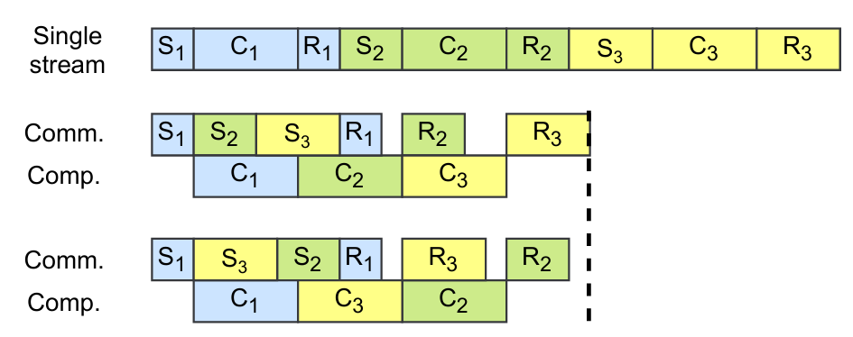
Existing research – Faster MoE (Basic idea)
Key point: Comm. Latency
Comp. Latency:
Comm. Latency:
Ratio
Avg Computation throughput
[1] He J, Zhai J, Antunes T, et al. Fastermoe: modeling and optimizing training of large-scale dynamic pre-trained models[C]//Proceedings of the 27th ACM SIGPLAN Symposium on Principles and Practice of Parallel Programming. 2022: 120-134.
Notes:
Bw batch length, H token length, P local throughput , matrix multiplication
L comm. Link, T traffic size, W bandwiths

Slide 14
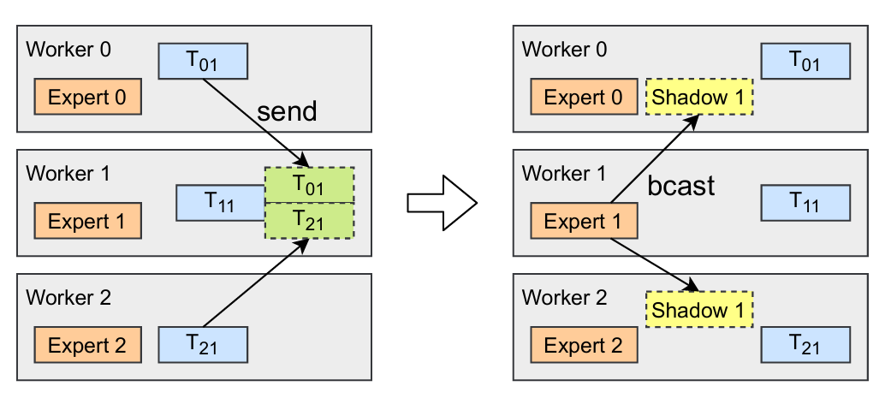
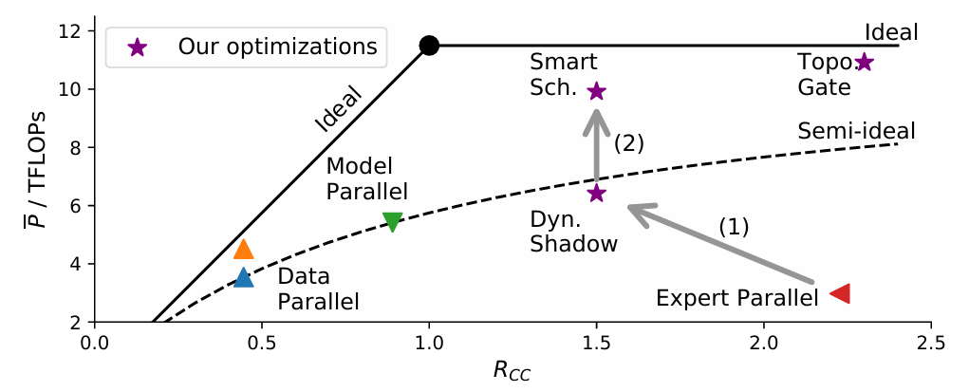
Existing research – Faster MoE (Strategy)
Dynamic Shadowing Strategy
Large token, not vary large expert
Shadow expert: which output used in others
Token broadcast -> model broadcast
Notes:
As the local datasets may be highly different, the differences contains the diversity in feature, label and data quantity
The first definition of no-iid belongs to the FL model, called Weight divergence. Researches in this area are struggling to generate no-iid dataset and evaluation no-iid level by dataset.
Obviously we can artificially split local data by label, but there is more reliable way: Dirichlet Distribution. It could split the local dataset with controllable distribution. The param alpha could control the similarity of local dis and label dis.
KS test is a classical non-parametric hypothesis test, used to identify if the distribution of two samples are similar
Empirical distribution function

Slide 15
Existing research – INFLOTA
Analog aggregation transmission
Signal Transmission
Power limited:
Received signal:
Received sum parameter:
All worker transmit params simultaneously
[1] Fan X, Wang Y, Huo Y, et al. Joint optimization of communications and federated learning over the air[J]. IEEE Transactions on Wireless Communications, 2021, 21(6): 4434-4449.
Notes:
D dimentional of w, P power control vector, beta transmission scheduling indicator, h channel gain, K is the number of local data sample
.

Slide 16
Outline
Introduction
Existing research
Proposed design and method
Preliminary results
Summary and future work

Slide 17
Challenges and Motivation
Problems in existing Distributed MoE methods
Ideal Comm. Env.
Data & device heterogeneity.
Top k expert selection.
Q: How to make MoE fit with real-world deployment?
Solutions: Distributed Mix of expert with Over-the-air (MoE-OTA)
How to select workers based on Comm. Cost?
How to select workers based on Dataset & local resource?
How to ensure data security?
Gate score &
Joint Optimization
Still working on it
Still working on it

Slide 18
Proposed Method: MoE-OTA
OTA: to enhance comm. efficiency
Parallel Input
OTA Aggregation
Gating
Network
OTA
Worker 0:
All-to-one comm.
Sum naturally
Cost Efficient Gate
Notes:
Evaluation of exploration: the convergence ratio, available searching space, diversity, flexibility

Slide 19
Proposed Method: Exploration Enhanced by EM
Experts selection: Token-target & comm. efficient
Initial gate score:
Improved gate score:
Comm. Cost
[1] Mahankali S, Hong Z W, Sekhari A, et al. Random Latent Exploration for Deep Reinforcement Learning[J]. arXiv preprint arXiv:2407.13755, 2024.
[2] Kim D, Shin J, Abbeel P, et al. Accelerating reinforcement learning with value-conditional state entropy exploration[J]. Advances in Neural Information Processing Systems, 2024, 36.

Slide 20

Proposed Method: Exploration Enhanced by EM
Experts selection: Token-target & comm. efficient
Cost in all-to-all and all-to-one comm.: Binary integer programming
For n workers, 1 server, given task f and input D, if the selected experts are deployed on $w=\{x\}$ workers.
OTA Aggregation
[1] Mahankali S, Hong Z W, Sekhari A, et al. Random Latent Exploration for Deep Reinforcement Learning[J]. arXiv preprint arXiv:2407.13755, 2024.
[2] Kim D, Shin J, Abbeel P, et al. Accelerating reinforcement learning with value-conditional state entropy exploration[J]. Advances in Neural Information Processing Systems, 2024, 36.

Slide 21
Outline
Introduction
Existing research
Proposed design and method
Preliminary results
Summary and future work

Slide 22
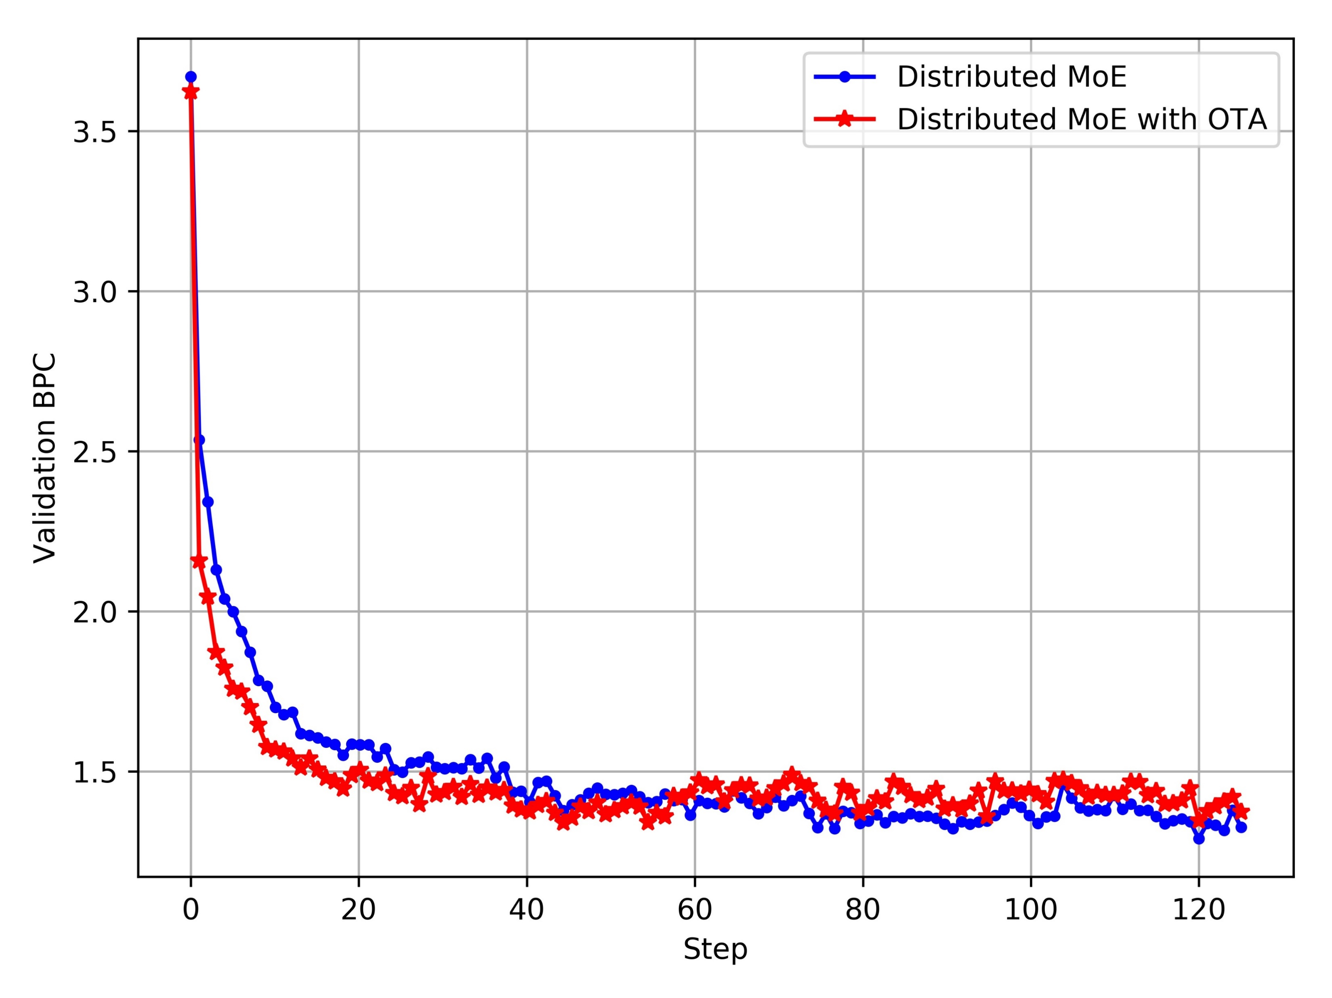
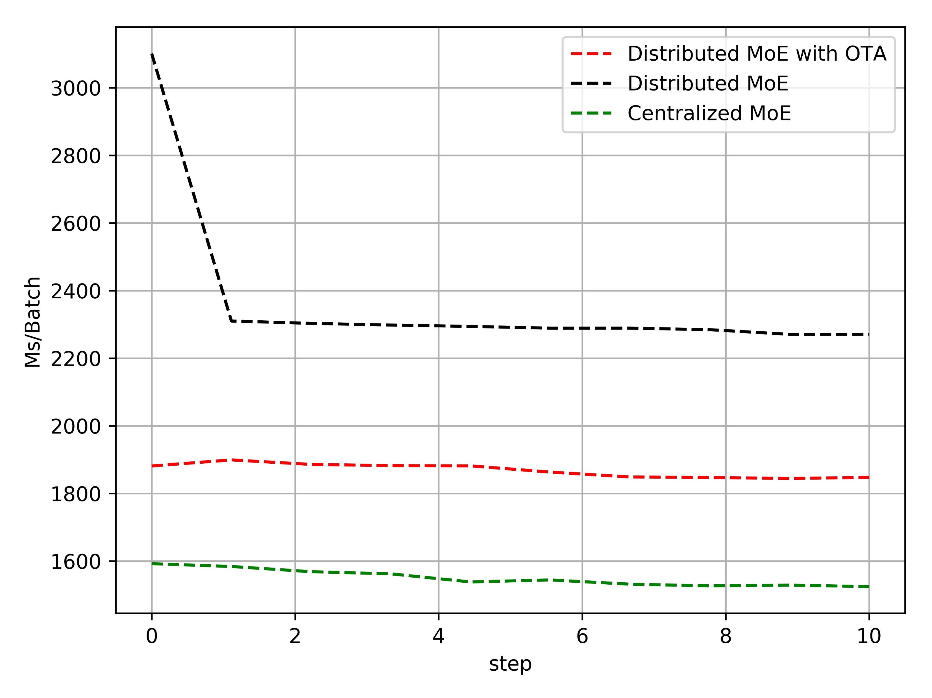
Simulation Result
Task: Word-level language modeling
Datasets: enwik8
Model: Transformer-XL: 12MoE layer (512, 1024), 823M params in each
Experiment setup: 8 workers, 64 experts, 40000 step/epoch, 1GPU.
Given bandwidth 50Gb/s, serial training
Results with seed 1111

Slide 23
Outline
Introduction
Existing research
Proposed design and method
Preliminary results
Summary and future work

Slide 24
Summary
MoE-OTA
Efficiency Comm.:OTA
All-to-all -> All-to-one
Existing issues
Non-i.i.d Local Dataset
Device Heterogeneity
First All-to-all comm. -> All-to-one comm.
Semi-distributed -> distributed
Cost based Expert Selection
Integer programming

Slide 25
Thank You!

